Slide 1

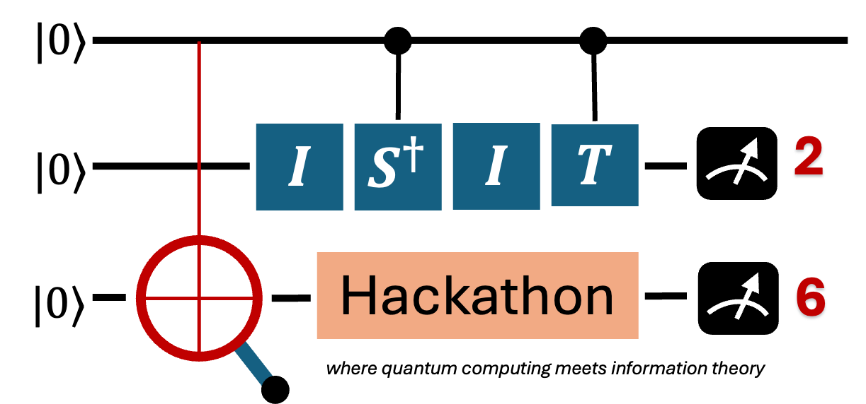
Team
logo
Team Name
Project Title -

Slide 2
Team
logo
Problem + Solution
Quantum Approach (Algorithm or Protocol)
Implementation & Tools (e.g., Qiskit, Cirq, PennyLane)
QC Advantage + Challenges & Mitigations

Slide 3
Demo Time
Spend 2-3 minutes demoing your hack. Make it engaging, fun, funny, and interesting. Use storytelling to engage judges and audience. Practice the flow of the demo and be fully prepared with back-ups.
Team
logo

Slide 4
Impact Problem impact & importance
Business Sustainability & Scalability Is the project viable to be shipped beyond the hackathon, potentially deployed as a product? Does it have a sustainable and scalable model?
Next Steps
Team
logo

Slide 5
Team
logo
Team Photo
List all Participants Name, University, Level, Country, Email

